Slide 1
SuperUsers HR System
Ortagus Winfrey
Mechal Terfie
Shenila Daredia
Dalya Khatun
Ryan Ocampo

Slide 2
Problem Statement
We aim to develop a flexible Human Resource Management System specifically for medium-sized Grocery store corporations. This system will utilize SQL for database inquiries. From this a company would be able to create departments as tables, and would allow employees to be placed into departments. A considerable business restraint would be that the system will have to be accessed via a web browser interface. Using the browser the HR department would log in to the system. From there they would be able to search for Employees using their Worker ID key from the table.Once the worker is pulled up other information about the worker stored in the table will also be displayed for the HR department.
Notes:
Business constraint- physical and software requirements for application to work

Slide 3
Roles
Ortagus Winfrey- Analyst
Ryan Ocampo- Architecture/back-end
Mechal Terfie- Backend/testing
Shenila Daredia- Frontend/back-end
Dalya Khatun- Frontend/back-end/testing
Notes:
Ortagus Winfrey-Analyst
Ryan OCampo-Architecture/backend
Mychal Terfie-Backend/testing
Shenila Daredia-Frontend/mysql development
Dalya Khatun-Frontend/backend; testing

Slide 4
Entities

Slide 5
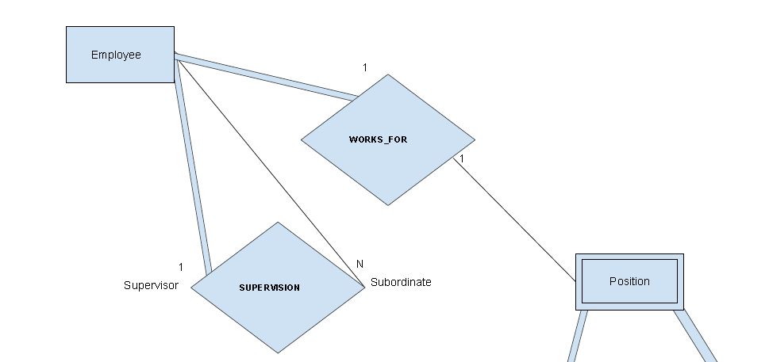
<Employee>
Workers that make up the company
Has a 1:1 relation with our <Position> entity
“Every employee works one position, but every position may not be filled by an employee.”
Full Participation
Notes:
Ortagus

Slide 6
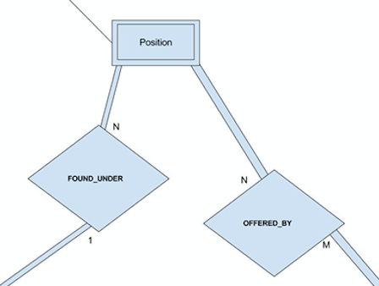
<Position>
Identifying role within the company
Has an N:1 relation with our <Department> entity
“Individual departments can have many positions”
Partial Participation
Notes:
Shenila

Slide 7
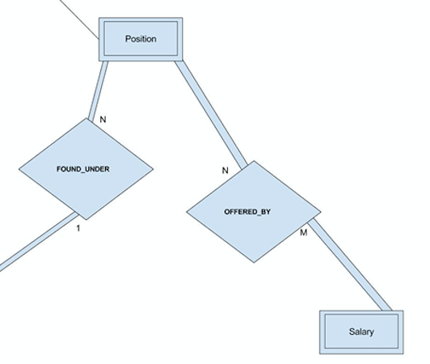
<Salary>
Initial income provided by work position
Has an M:N relation with our <Position> entity
“There can be one, or numerous positions that have the same, or different, salaries.”
Full Participation
Notes:
Ryan

Slide 8
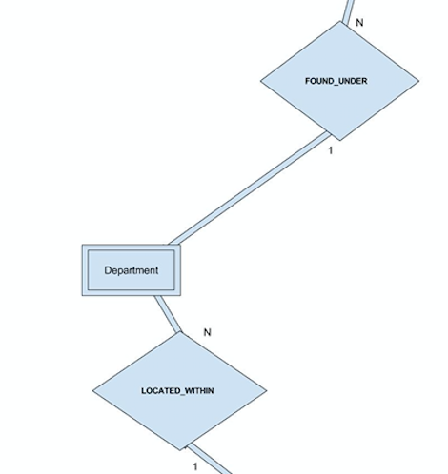
<Departments>
Specified divisions that focus on different production aspects of a company
Has an N:1 relation with our <Store> entity
“Various amounts of departments can be considered for each store.”
Full Participation
Notes:
Mechal

Slide 9
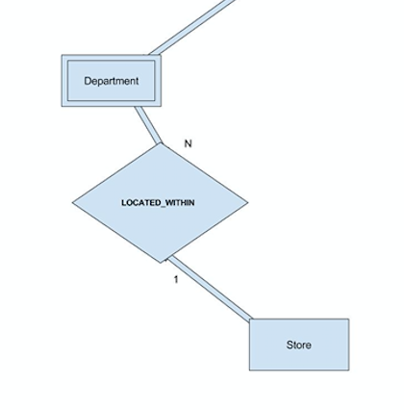
<Store>
The location where each employee,position, and department are located.
Has an 1:N relation with our <Department> entity
“Individual stores can have many departments.”
Partial Participation
Notes:
Dalya

Slide 10
ER Diagram

Slide 11
